Slide 1
Week 6: Probability and sampling PSYC121: Statistics for Psychologists
Dr Tom Beesley
t.beesley@lancaster.ac.uk

Slide 2
Objectives
To appreciate the probability with which events occur
To understand what we expect when we draw samples
To think about simple experimental tests
To understand how we can test if a result is “unusual”

Slide 3


Data in a normal distribution
X = 23
Z = -.52
X = 45
Z = +.78
Miles driven per week

Slide 4
Variables affecting behaviour
Why does John drive more miles per week?
 | John | Tom
Vegan | YES | NO
Age | Old | Young
Number of children | 0 | 3
Part-time racing driver | YES | NO
Cycling enthusiast | NO | YES
Published papers | 65 | 43
N.B. – these data are fictitious!
It is hard to understand behaviour by looking at individuals

Slide 5
Do variables affect where data lie in the distribution of scores?
Do vegans drive more each week?
Do non-vegans drive less each week?
X = 45
Z = +.78
0
Miles driven per week
We want to make inferences about behaviour (e.g., driving) that we can measure, by looking at how that is influenced by other variables (e.g., being vegan) we have some control over.

Slide 6
Testing if variables affect behaviour
Inferential statistical tests help us to determine whether variables affect behaviour.
Is memory performance different in the morning vs. the afternoon?
Student | Morning | Afternoon | Size of improvement
Bob | 6 | 9 | +3
Jane | 8 | 7 | -1
Hanbit | 9 | 10 | +1
Ivanka | 4 | 5 | +1
Donald | 1 | 0 | -1
Joe | 6 | 8 | +2
 |  |  | Mean = 0.833

Slide 7
QUESTIONS for you!
Your example experiment where H₀ is true
1. What is the null hypothesis (H₀)?
2. What would the mean improvement score be?
3. What would the data look like if the null hypothesis was true? To do this, sketch a normal distribution and put on 15 points for a given experiment.
0

Slide 9
Normal distribution and the null hypothesis

Slide 10
Normal distribution and the null hypothesis
0
e.g., memory improvement

Slide 11
Normal distribution and the null hypothesis
0
e.g., memory improvement

Slide 12
Normal distribution and the null hypothesis
0
e.g., memory improvement

Slide 13
When do samples start to become “unusual”?
When we do experiments, we set up a null hypothesis:
What do we expect if there is NO EFFECT
In our memory experiment this is: IMPROVEMENT SCORE = 0
If the null hypothesis is TRUE, we expect something close to 0
BUT (and this is really important) it won’t always be exactly 0

Slide 14
What is unusual?
Student | Morning | Afternoon | Size of improvement | Direction of change
Bob | 6 | 9 | +3 | +
Jane | 8 | 7 | -1 | -
Hanbit | 9 | 10 | +1 | +
Ivanka | 4 | 5 | +1 | +
Donald | 1 | 0 | -1 | -
Joe | 6 | 8 | +2 | +
 |  |  | Mean = 0.833 | 4 positive / 2 negative
Is 0.833 different to 0? Numerically, yes.
But is it unusual enough to make it noteworthy?
Is 4 out of 6 unusual enough to make it noteworthy?

Slide 15
Probability
Student | Morning | Afternoon | Direction of change
Bob | 6 | 9 | +
Jane | 8 | 7 | -
Hanbit | 9 | 10 | +
Ivanka | 4 | 5 | +
Donald | 1 | 0 | -
Joe | 6 | 8 | +
 |  |  | 4 positive / 2 negative
Hypothesis: memory scores are different in the morning and afternoon
How unusual are these data?
Result | 6+ / 0- | 5+ / 1- | 4+ / 2- | 3+ / 3- | 2+ / 4- | 1+ / 5- | 0+ / 6-
Probability | 0.02 | 0.09 | 0.23 | 0.31 | 0.23 | 0.09 | 0.02

Slide 16
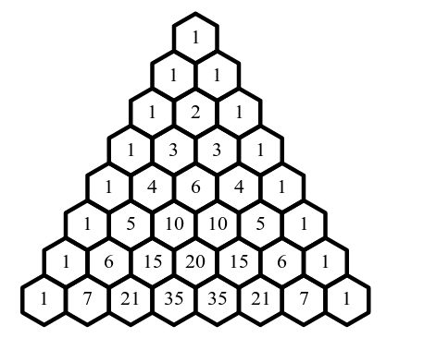
Probability
The null hypothesis (H₀)
“There is no difference between morning and afternoon testing”
If true, we would expect the following results with the following probabilities
Result | 6+ / 0- | 5+ / 1- | 4+ / 2- | 3+ / 3- | 2+ / 4- | 1+ / 5- | 0+ / 6-
Probability | 0.02 | 0.09 | 0.23 | 0.31 | 0.23 | 0.09 | 0.02
Frequency | 1/64 | 6/64 | 15/64 | 20/64 | 15/64 | 6/64 | 1/64

Slide 17
Probability
Result | 6+ / 0- | 5+ / 1- | 4+ / 2- | 3+ / 3- | 2+ / 4- | 1+ / 5- | 0+ / 6-
Probability | 0.02 | 0.09 | 0.23 | 0.31 | 0.23 | 0.09 | 0.02
Frequency | 1/64 | 6/64 | 15/64 | 20/64 | 15/64 | 6/64 | 1/64
These probabilities are very low, so these results are quite extreme “under the null hypothesis”
Therefore, if we get a result that’s 6+ or 6- (out of 6), we consider that “unusual”
The probability of the data, given the null hypothesis, is less than 5%.
We reject the null hypothesis
Hypothesis: memory performance is different in the morning and afternoon

Slide 18
Task for you!
Result | 6+ / 0- | 5+ / 1- | 4+ / 2- | 3+ / 3- | 2+ / 4- | 1+ / 5- | 0+ / 6-
Probability | 0.02 | 0.09 | 0.23 | 0.31 | 0.23 | 0.09 | 0.02
Frequency | 1/64 | 6/64 | 15/64 | 20/64 | 15/64 | 6/64 | 1/64
Is your coin biased or not?
Take a coin and flip it 6 times
Write down how many heads you get
Make a tally chart for how many times you get 1/2/3/4/5/6 heads
Do this as many times as you like (N times)
What was the probability of getting 3 heads out of N? = “tally for 3”/N
What was the probability of getting 2….
Do your probabilities match those above?

Slide 19
What is a “significant result”?
It relates to how likely a result is under the null hypothesis (H₀)
ALL RESULTS are *possible* under H₀

Slide 20
Normal distribution and the null hypothesis
0
e.g., memory improvement

Slide 21
Normal distribution and the null hypothesis
0
e.g., memory improvement

Slide 22
Normal distribution and the null hypothesis
0
e.g., memory improvement

Slide 23
What is a “significant result”?
It relates to how likely a result is under the null hypothesis (H₀)
ALL RESULTS are *possible* under H₀
but some results are less likely, and some VERY *unlikely*.
We can estimate this by computing the “p value”…

Slide 24
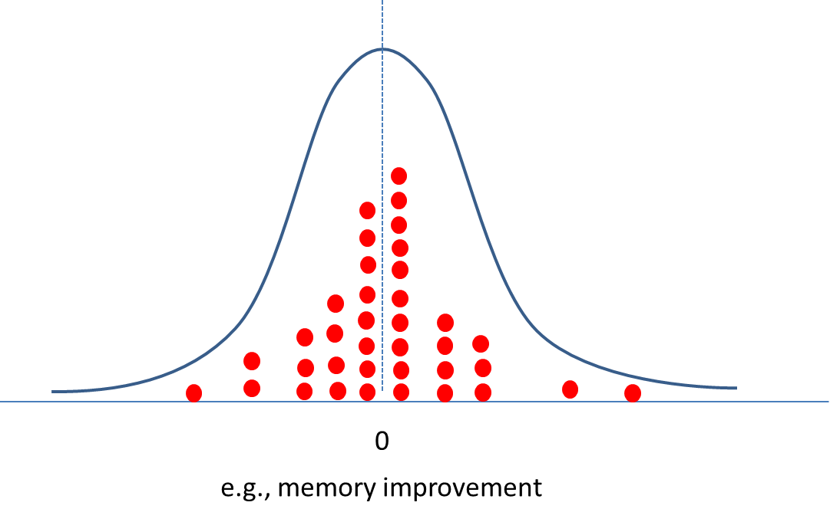
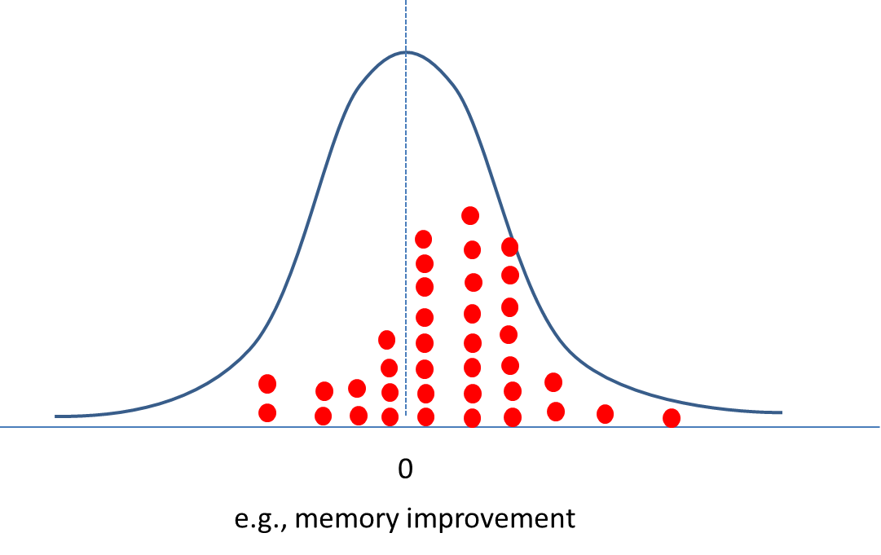
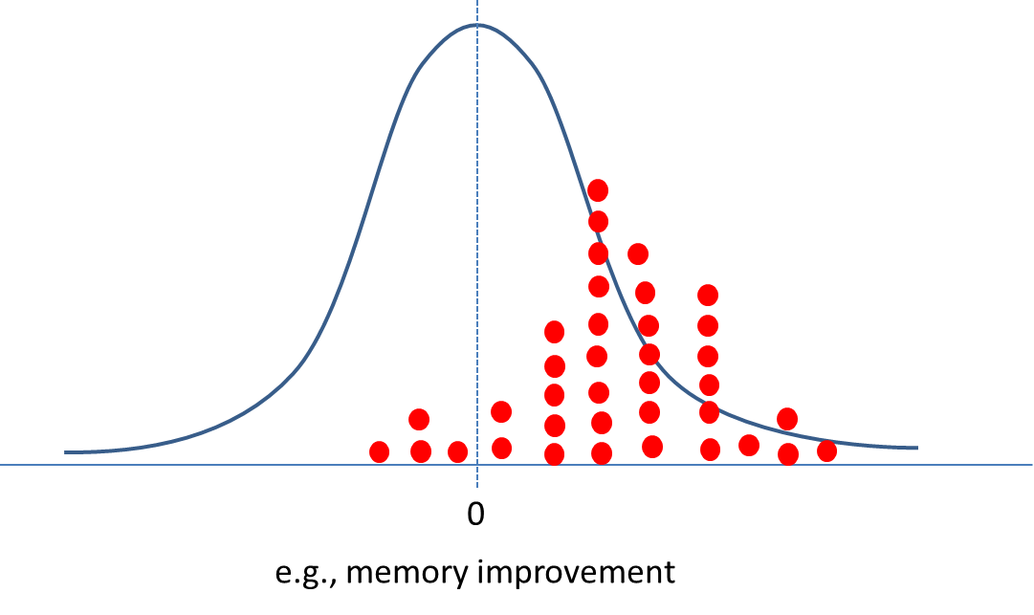
P values
e.g., p = .9
This is the probability of the data, if the null hypothesis was true
It reflects how likely we would be to observe a pattern of data like this, if there was actually no effect in
e.g., p = .3
e.g., p = .04

Slide 25
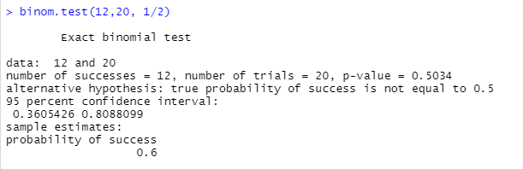
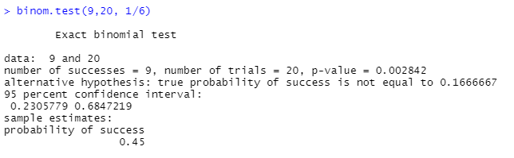
Binomial Test
Gives the probability of seeing exactly X number of same events out of Y, where each event has an independent probability of Z…
E.g., what is the probability of getting 12 heads from 20 flips, given the probability of a head on each flip is 1/2 (.5).
E.g., what is the probability of getting 9 “6s” out of 20 dice rolls, given the probability of getting a 6 each roll is 1/6 (.167)

Slide 26
How should p values be interpreted?
Our convention is p < .05 is “significant”
We conclude that the probability of the data, given the null hypothesis is true, is so low that we reject the null hypothesis
BUT!!!!
ALL RESULTS are *possible* under H₀

Slide 27


Type 1 vs. Type 2 errors
Why don’t we set our Type 1 error rate at 1% or 0.1% or 0.01% ?!
Because then we’d fail to reject H₀ when it was false (a Type 2 error)
If our Type 1 error rate is lowered (to say 1% = prob 0.01)
Type 2
Type 1
Result | 6+ / 0- | 5+ / 1- | 4+ / 2- | 3+ / 3- | 2+ / 4- | 1+ / 5- | 0+ / 6-
Probability | 0.02 | 0.09 | 0.23 | 0.31 | 0.23 | 0.09 | 0.02
Frequency | 1/64 | 6/64 | 15/64 | 20/64 | 15/64 | 6/64 | 1/64
If our Type 1 error rate is raised (to say 10% = prob 0.10)
Type 1
Type 2
Result | 6+ / 0- | 5+ / 1- | 4+ / 2- | 3+ / 3- | 2+ / 4- | 1+ / 5- | 0+ / 6-
Probability | 0.02 | 0.09 | 0.23 | 0.31 | 0.23 | 0.09 | 0.02
Frequency | 1/64 | 6/64 | 15/64 | 20/64 | 15/64 | 6/64 | 1/64

Slide 28
Summary
We draw samples in order to provide estimates of what is true
We can say how likely these data would be IF THERE WAS NO EFFECT
This probability tells us whether our data are likely UNDER THE NULL HYPOTHESIS
Small p values (i.e., p < .05) will lead us to REJECT THE NULL HYPOTHESIS
BUT we are always in danger of doing this in error (a Type 1 error)

Slide 29
Reading
Chapter 8: Statistical Distributions and Hypothesis Testing
Howell, D. (2017). Fundamental statistics for the behavioral sciences (Ninth ed.). Australia: Cengage.

